Slide 1
Food Webs

Slide 2
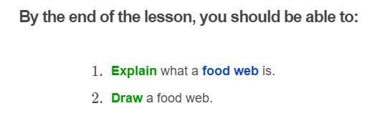
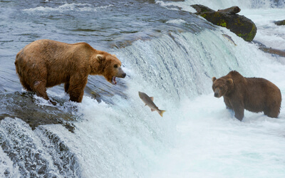

Slide 3
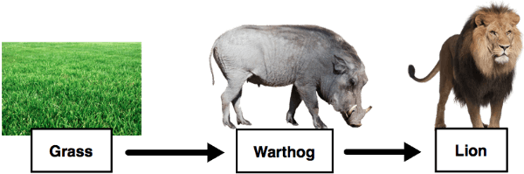
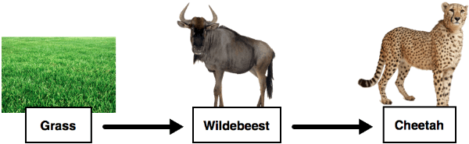
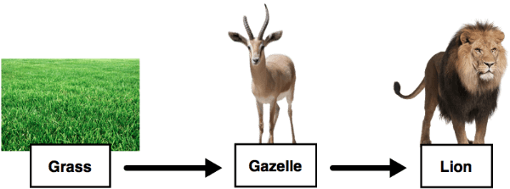
Take a look at each of these food chains:

Slide 4
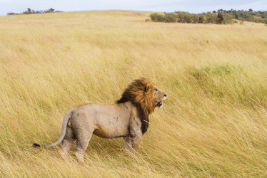
All of these food chains occur in the same ecosystem - the African Savannah.

Slide 5
More than one food chain usually exists within an ecosystem, since there are so many organisms!
All of the interlinked food chains within an ecosystem are known as a food web.
The three food chains from before can all be represented much more easily in a food web.

Slide 6
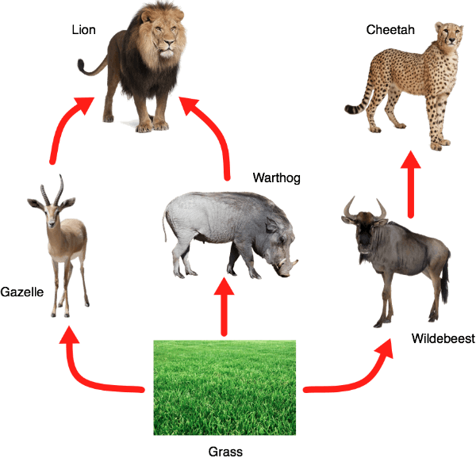

Slide 7
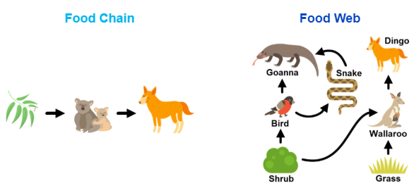
A food web is simply a collection of all the food chains in an ecosystem.
The diagrams below show the comparison between a food chain and a food web.
Remember: The arrows point to the organism that is doing the eating!

Slide 8
